Slide 1
Vagi Tamari
CPF Superintendent
(Central Processing Facility)
Notes:
2 min
THIS IS A GUIDANCE SLIDE PACK TO GUIDE REPORTS ON THE ELT AGREED BUSINESS MODEL.
IT COVERS:
WHERE DOES OUR WAY FIT INTO THE STRATEGIC PLAN AS INITIATIVE 8
WHERE THE LEADERSHIP FRAMEWORK FITS AS A COMPONENT OF OUR WAY
AND HOW THE BEHAVIOURS FITS AS THE ESSENTIAL BUILDING BLOCK OF FUTURE SUCCESS (Noting that in a local context it needs to be seen as an extension of the successful SLEW courses and not another new concept)
It is simply how we are going to operate.

Slide 2
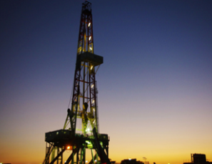
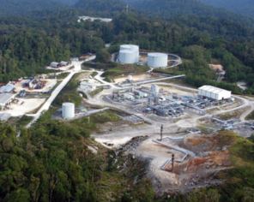
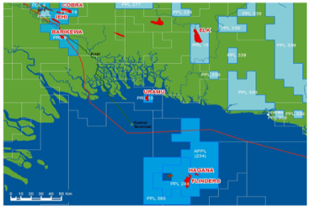
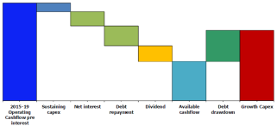
Vision
To generate top-quartile returns for shareholders through excellence in socially responsible oil and gas exploration and production.
Objective
Achieve top-quartile value growth performance versus peer group, over the next five years by pursuing these key strategies:
Strategies
Commercialise a Highlands-resourced LNG train
Optimise our portfolio through active exploration
Promote a stable operating environment in PNG
Enhance organisation capability to deliver strategy
2
4
6
8
Sustain and optimise value of existing assets
Commercialise a Gulf Hub-resourced LNG train
Deliver new ventures consistent with our vision
Optimise capital and liquidity management
1
3
5
7
Notes:
1 min
First link is to the company’s vision and strategic plan, of which OSL has 8.
OUR WAY is Initiative 8 in that strategic plan (Enhance the organisations capability). Introduce ‘Our Way’ as the focus of this presentation

Slide 3
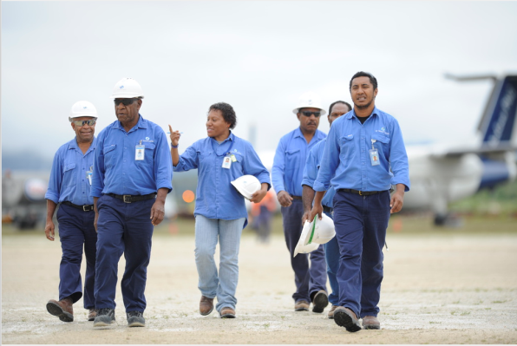
Enhance organisation capability to deliver strategy
Strategy 8:
Action
Benefit
Implement BU/Functional Structure
Ensures we have structure to deliver on our vision
Chase our core strategy
Establish the Gas Development Business Unit
Captures advantages; identifies gaps
Develop an activity & workforce planning model
Deliver identified priority capability initiatives
Mitigates risks associated with our growth
Institutionalise our new ‘Our Way’ management system
An aligned and focused leadership team
Deliver knowledge management system
Captures and fully utilise our knowledge
Notes:
1 min
Second link is actions are agreed in the strategic plan that require a system that provides guidance and structure to Supervisors to fulfil the vision and corporate objectives.
Provides clarity and boundaries for subordinates to work within. Removes the ability to use personal ( i ) moments of success as reasons for thinking this is good for this business.
Focusses people on the needs of the business rather than personal views

Slide 4
Our Focus
Today’s Focus
Notes:
30 seconds
The Focus of this particular presentation is on Leadership and the skills and behaviours components within that.

Slide 5
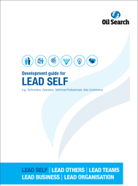
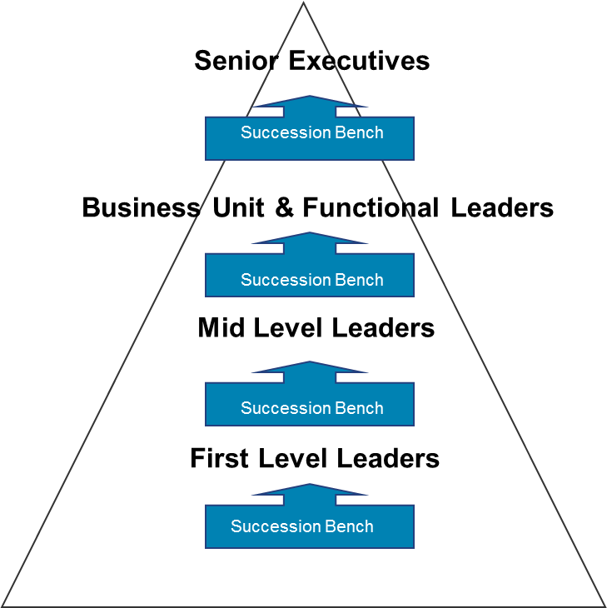
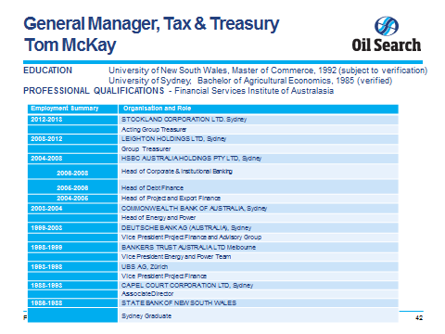
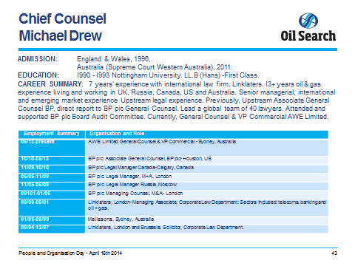
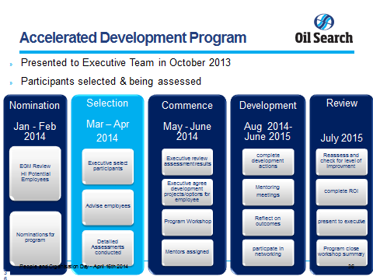
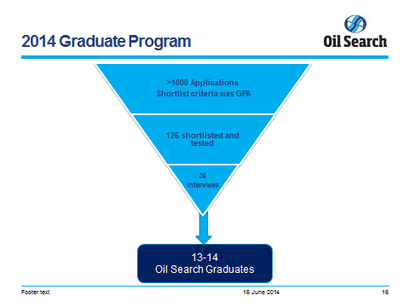
Leadership Framework applied We either Make or Acquire our leaders externally
“Make”
Talent Needs / Bench strength
“Acquire”
Development Guides
based on Leadership Framework
Recruit leaders using new recruitment guides or success profiles based on Leadership Framework
Performance Management
rates leaders on
leadership behaviours
Leadership Development Programs based on
Leadership Framework
Use assessments for large -scale recruitment based on Leadership Framework
Notes:
2 min
Third Link - Leadership framework is a component of OUR WAY
YOU CAN EITHER MAKE OR ACQUIRE LEADERS. WE WANT TO INVEST IN PEOPLE THAT WANT TO PROGRESS. HIGHEST PERFORMING COMPANIES HAVE LEADERS FROM WITHIN.
Disregard the rest and MOVE ON FROM THIS SLIDE.

Slide 6
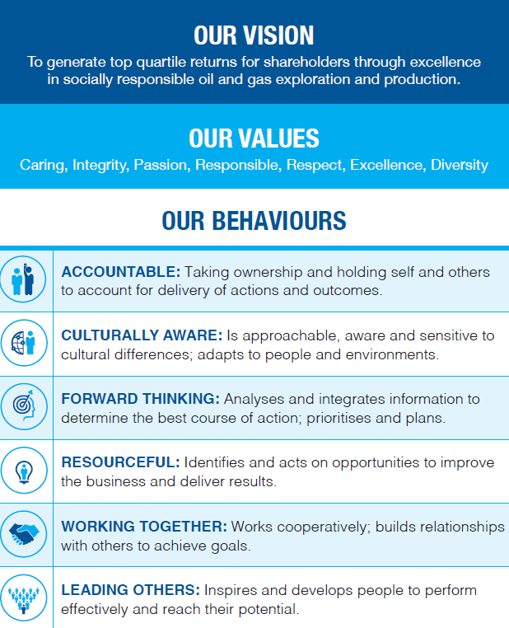
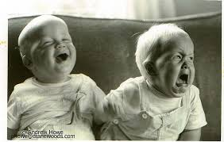
Behaviour underpins performance.
A solid foundation is required for success
Notes:
3 min
Fourth LINK - BUSINESS AGREED BEHAVIOURS ARE ESSENTIAL TO BUILD A CORNERSTONE FOR FUTURE SUCCESS.
This isn’t a new concept. We are a successful company that needs to grow.
It will be embedded in everything we do.
Our Values are core to who OSL is. THIS IS BOARD ENDORSED
Our behaviours are essential to building the OSL that is required to achieve the vision and objectives
Highlight OSL behaviours

Slide 7
How it all fits together - Summary
Vision
Strategy 8:
Our way
Institutionalising Our Way
Leadership Framework
Behaviours
Notes:
Just reiterating the hierarchy

Slide 8
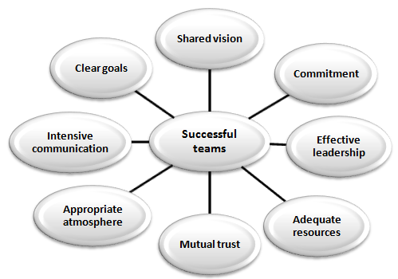
Final
Clear Guidance for all levels
It is how we will do things
Embedded in all people related processes
Success is the outcome
END
Notes:
FINAL WRAP
3 min
A successful company that wants to go places and wants its loyal staff to grow with it. Not just be a part of the success, rather be inspired to create that success and lead from the front.
Solicit 3 cheers from the team!!

